Slide 1
A Hybrid Model for the Classification of Sunflower Diseases Using Deep Learning
Team 02
Md. Tariqul Islam
23173006

Slide 2
Background
Prediction and Recognition of plant disease in the early stage.
Sunflower is one of the major oilseed crops in the world, and its production is severely affected by various diseases.
Deep learning techniques are used widely to classify or predict diseases by using images.
Paper proposed a hybrid model of deep learning to classify the sunflower diseases, i.e. Alternaria leaf blight, Downy mildew, Phoma blight, and Verticillium wilt.
To make a hybrid model authors used the stacking ensemble learning technique and combine two models i.e. VGG-16 and MobileNet,

Slide 3
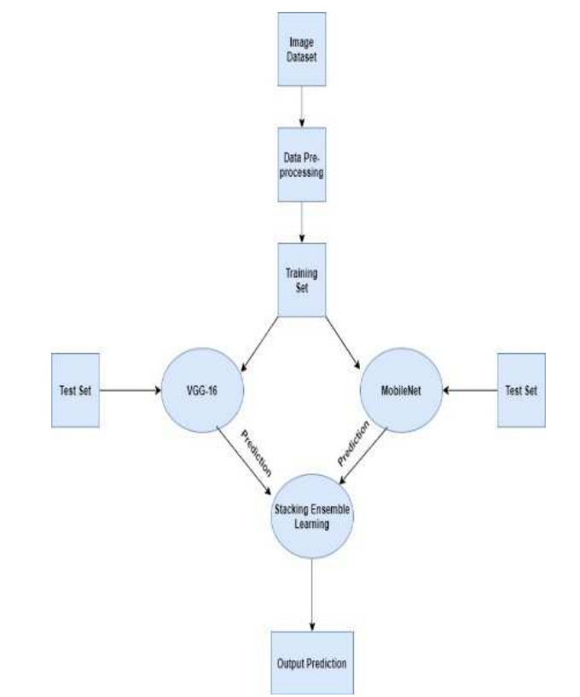
Proposed Model
Fig-1: Flow Diagram

Slide 4
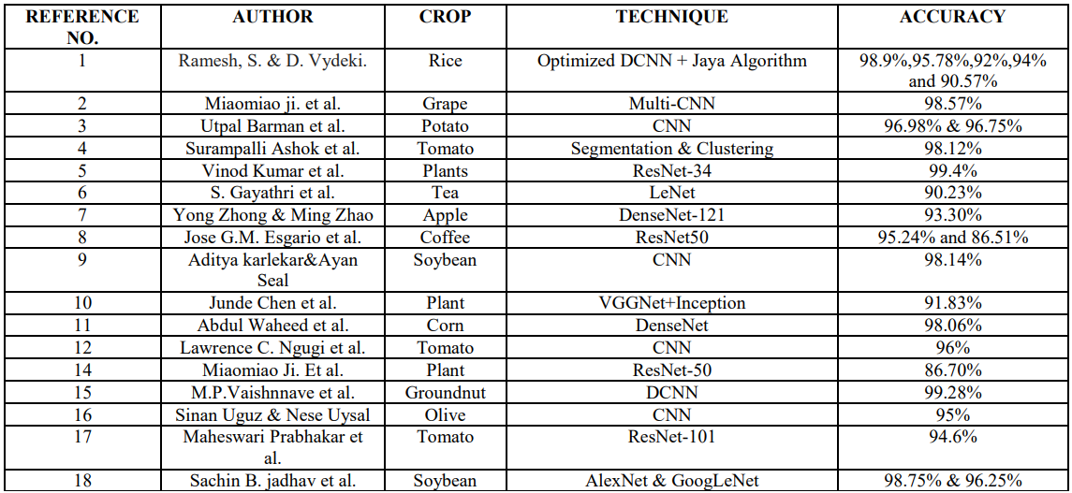
Related Work

Slide 5
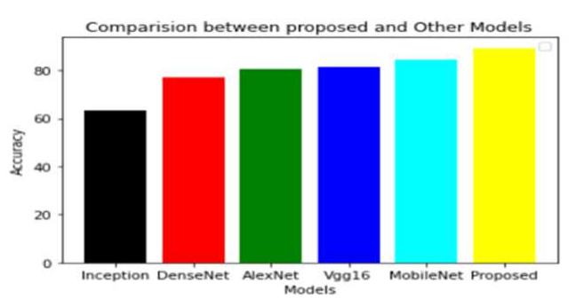
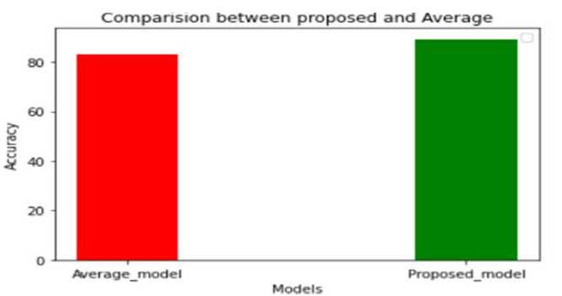
Result & Discussion
Fig-2
Fig-3

Slide 6
Conclusion
In this work, authors proposed an optimal hybrid model to classify the diseases of sunflower leaf with the help of the stacking ensemble learning technique that combine Vgg16 and MoileNet models. In This work we used this model to classify 5 classes of the sunflower which consist of 4 diseases which are given Alternaria leaf spot, Downy Mildew, Phoma Blight, and Verticillium wilt, and 1 is healthy leaf class. They tried to apply two techniques of ensemble learning i.e. stacking and weighted average but stacking provide the better result. The result and analysis shows that our method gave an accuracy of 89.2% which is better than the other deep learning models i.e. AlexNet, Inception_V3, DenseNet-121, Vgg-16, and MobileNet on our own dataset.
Thank You

